Slide 1
DHANUSHRI S (2021506017) BTech Information Technology Madras Institute of technology

Slide 2
Generating Cartoon Images using DC-GAN

Slide 3
Agenda
Problem Statement
Project Objective
End Users
DC-GAN
GAN Model
Model Training
Model Prediction
Result
Demo vedio

Slide 4
PROBLEM STATEMENT: Cartoon images have always been a source of fascination and creativity, serving various purposes from entertainment to communication. However, generating high-quality cartoon images with desired attributes manually can be time-consuming and labor-intensive. In this context, the task is to develop a Deep Convolutional Generative Adversarial Network (DC-GAN) model capable of autonomously generating cartoon images with diverse styles and features.

Slide 5
PROJECT OBJECTIVE:
The primary objective of this project is to train a DC-GAN model to generate realistic cartoon images that mimic the style and characteristics of the input dataset. The key objectives include:
Develop a robust DC-GAN architecture: Design and implement a generator and discriminator network architecture adhering to the principles of DCGAN, including strided convolutions, batch normalization, and appropriate activation functions.
Dataset Preparation: Preprocess and curate a dataset of 2D cartoon avatar images to serve as the training data for the DC-GAN model.

Slide 6
.
3.Training the Generator and Discriminator: Train the generator to produce synthetic cartoon images that are indistinguishable from real ones, while simultaneously training the discriminator to accurately distinguish between real and generated images.
4.Model Deployment: Deploy the trained DC-GAN model to generate cartoon images on-demand, facilitating easy access and utilization by end-users.
5.Fine-tuning and Optimization: Experiment with different hyperparameters, network architectures, and training strategies to optimize the performance of the DC-GAN model.
6.Model Deployment: Deploy the trained DC-GAN model to generate cartoon images on-demand, facilitating easy access and utilization by end-users.

Slide 7
.
END USERS: Artists and Illustrators: Professionals seeking inspiration or reference for creative projects. Content Creators: Studios, game developers, filmmakers, and influencers enhancing their content with cartoon images. Avatar and Profile Platforms: Websites and apps offering avatar customization services. Educational Institutions: Schools using cartoon images for teaching digital art and animation. VR/AR Developers: Incorporating cartoon images into virtual and augmented reality experiences. Mobile App Developers: Integrating cartoon images into chat, gaming, and entertainment apps. General Users: Individuals creating personalized avatars or enjoying cartoon imagery for entertainment.

Slide 8
DC-GAN:
Deep Convolutional GAN is a generative adversarial network architecture. It uses a couple of guidelines, in particular:
Replacing any pooling layers with strided convolutions (discriminator) and fractional-strided convolutions (generator).
Using batchnorm in both the generator and the discriminator.
Removing fully connected hidden layers for deeper architectures.
Using ReLU activation in generator for all layers except for the output, which uses tanh.
Using LeakyReLU activation in the discriminator for all layer.

Slide 9
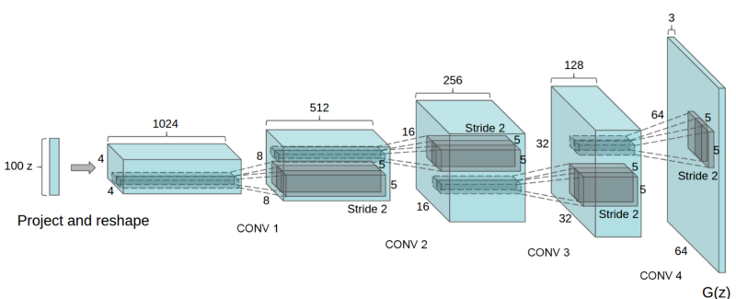
DC-GAN:

Slide 10
GAN MODEL:
Define Generator and Discriminator network architecture
Train the Generator model to generate the fake data that can fool Discriminator
Train the Discriminator model to distinguish real vs fake data
Continue the training for several epochs and save the Generator model

Slide 11
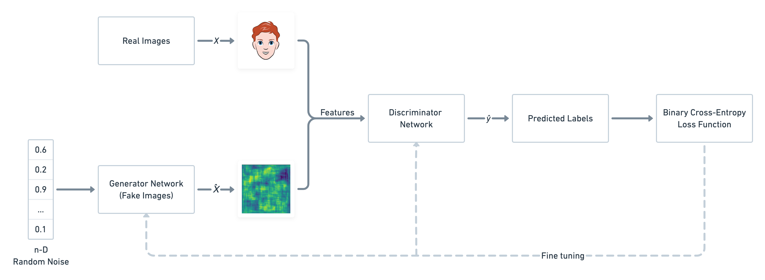
GAN MODEL

Slide 12
MODEL TRAINING:

Slide 13
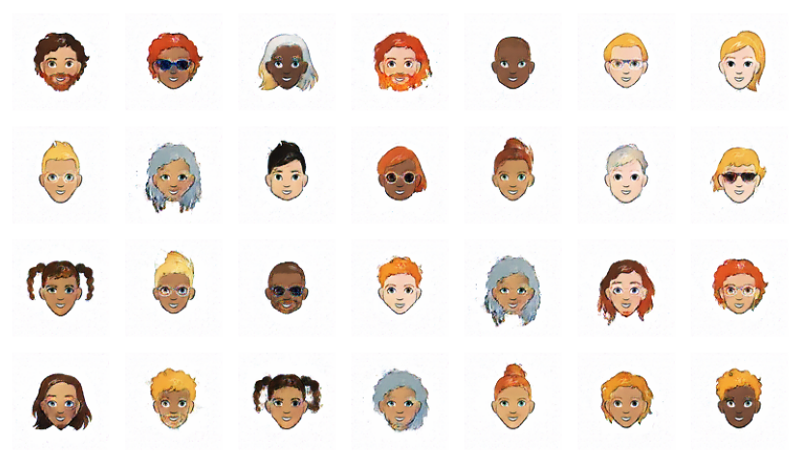
MODEL PREDICTION:

Slide 14
RESULT:
The result of cartoon generation using CGAN could be an image that resembles a cartoon character with distinct features such as exaggerated facial expressions, vibrant colors, and stylized elements. The generated cartoon may exhibit various characteristics based on the conditioning information provided to the model. For example, if the condition specifies certain attributes like gender, age, or hairstyle, the generated cartoon character may reflect those attributes accordingly.
DEMO_LINK

Slide 15
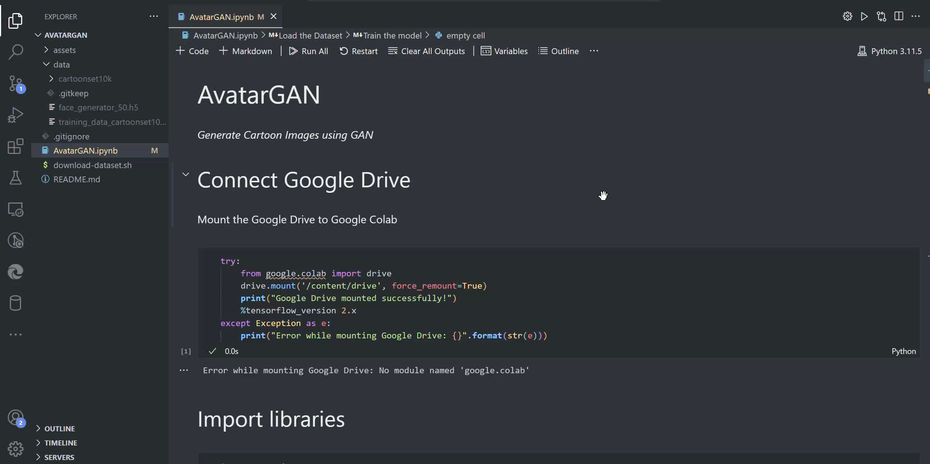
DEMO VEDIO:

